Slide 1
Alpha Predictor
Block Diagram
Overview
Predict Phase
Update Phase

Slide 2
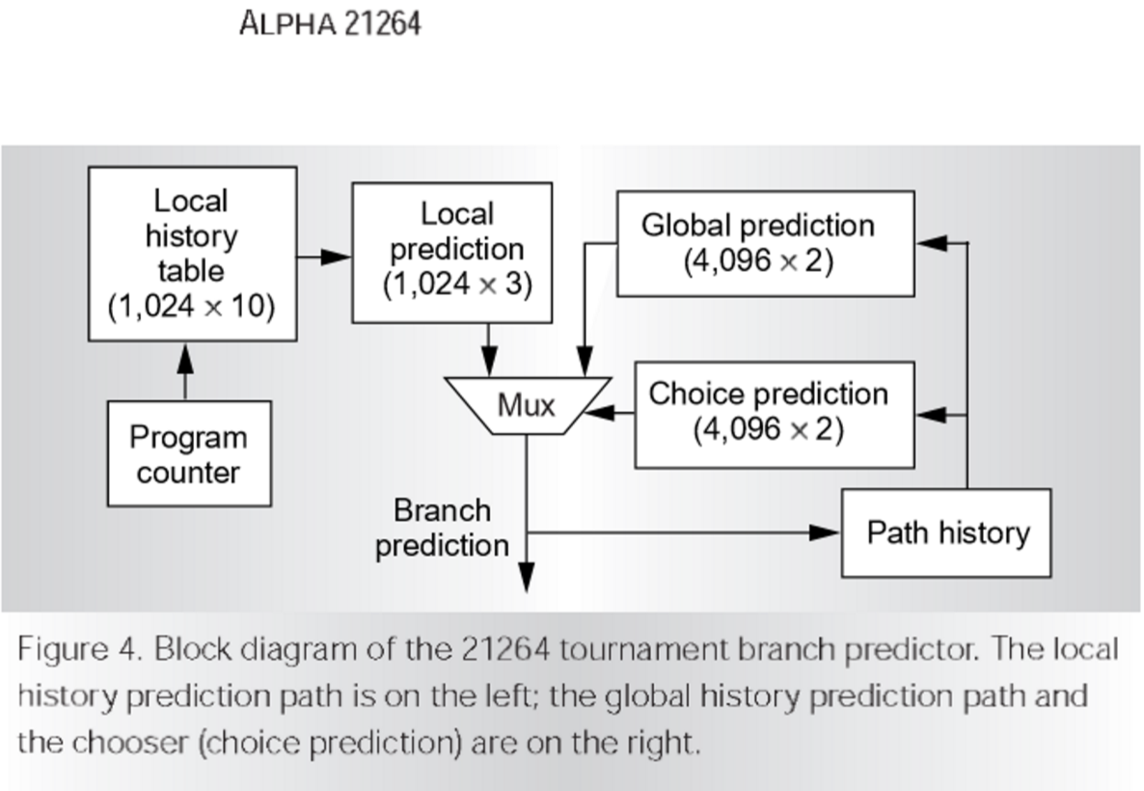
Alpha Branch Prediction Block Diagram

Slide 3
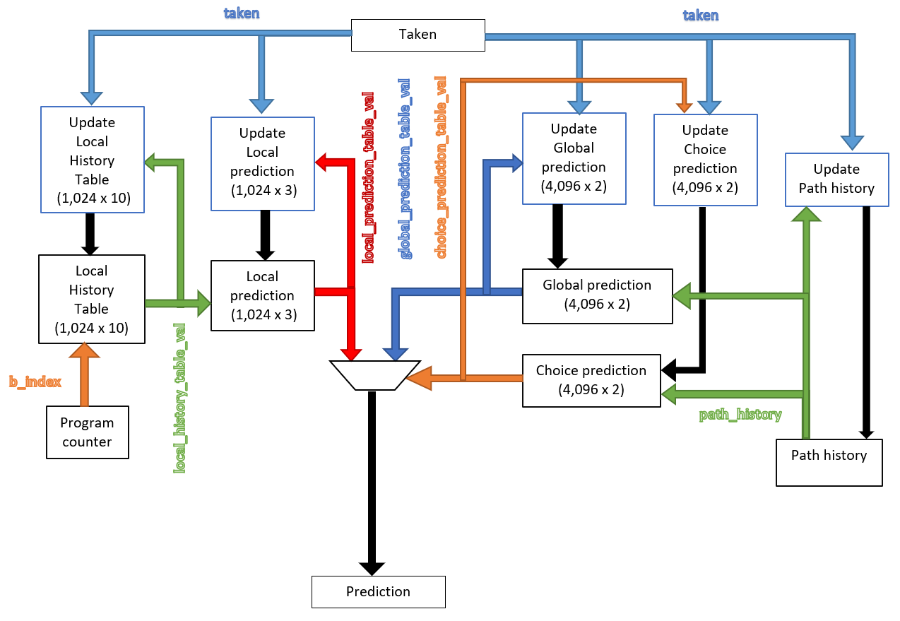
Overview

Slide 4
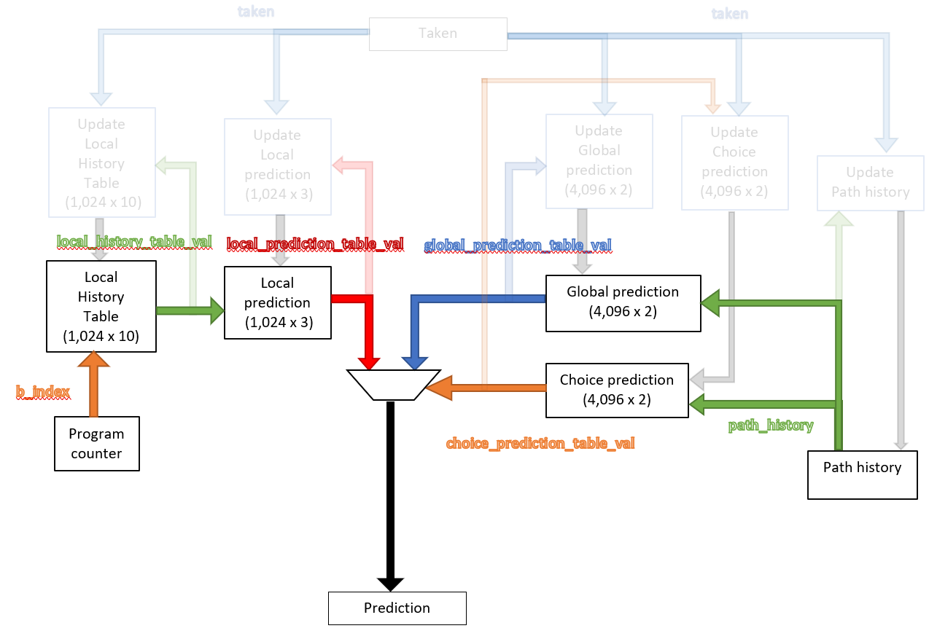
Predict Phase

Slide 5

Update Phase

